Slide 1

Predicting Paychecks
Analyzing the Analytics Job Market
Case 8 - Understanding Predictive Models and Complex Relationships
Maxwell Dean

Slide 2
Why?
Job postings have a variety of information besides salary

Slide 3
Predicting Salaries can…
Ensure a Fair and Competitive salary
1
Negotiate higher salaries with confidence
2
Drive Career Progression
3

Slide 4
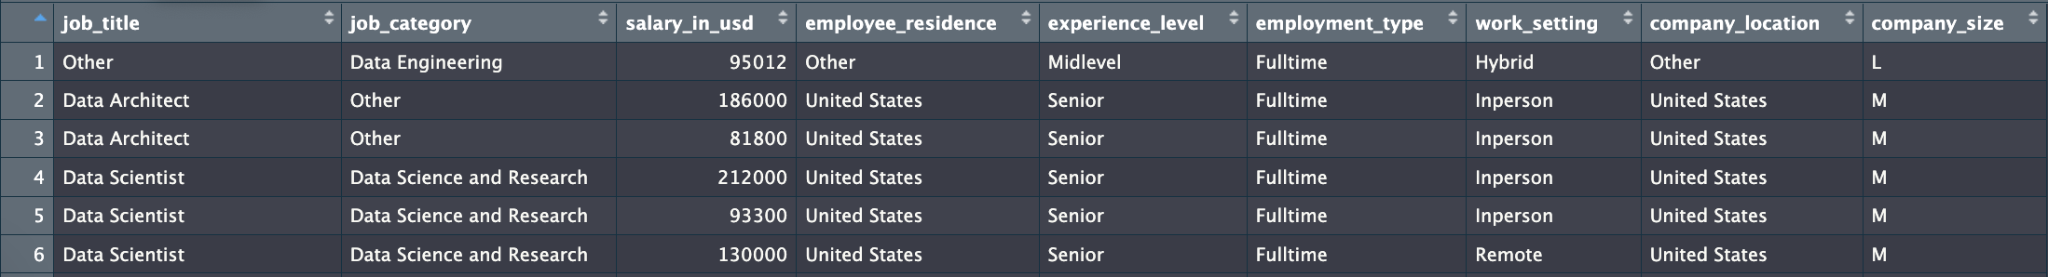
Salaries of Jobs in Data Science / Analytics
7000+ Job Postings from 2023
Overall, average salary: $155000

Slide 5
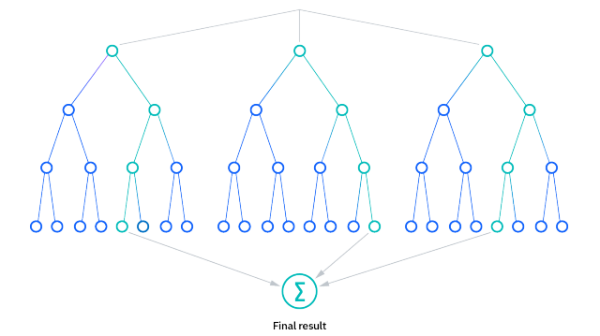
Random Forest Model
Creates a ‘Forest’ of multiple Decision Trees
Each tree makes decisions based on asking questions on different parts of the dataset.
Each tree’s decision contributes to a unified prediction, enhancing the model’s overall trustworthiness
Notes:
Show example related to dataset! treewise

Slide 6
Model’s Accuracy
On average, the model’s predictions are about $5,130 off.
This is much better than just guessing based on the average salary, which would be wrong by about $62,663.
Notes:
R-squared - % of the way there

Slide 7
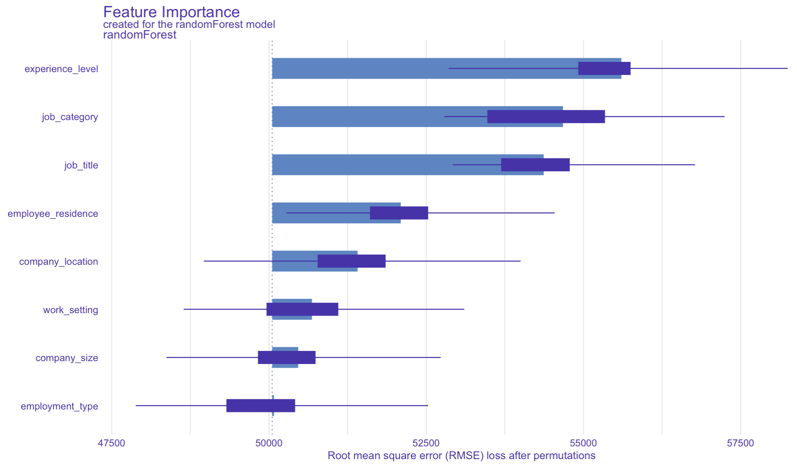
Experience level, Job Titles/Category, & Location are the best indicators of salary
Experience Level
Job Category
Job Title
Employee Residence
Company Location
Work Setting
Company Size
Employment Type
47500

Slide 8
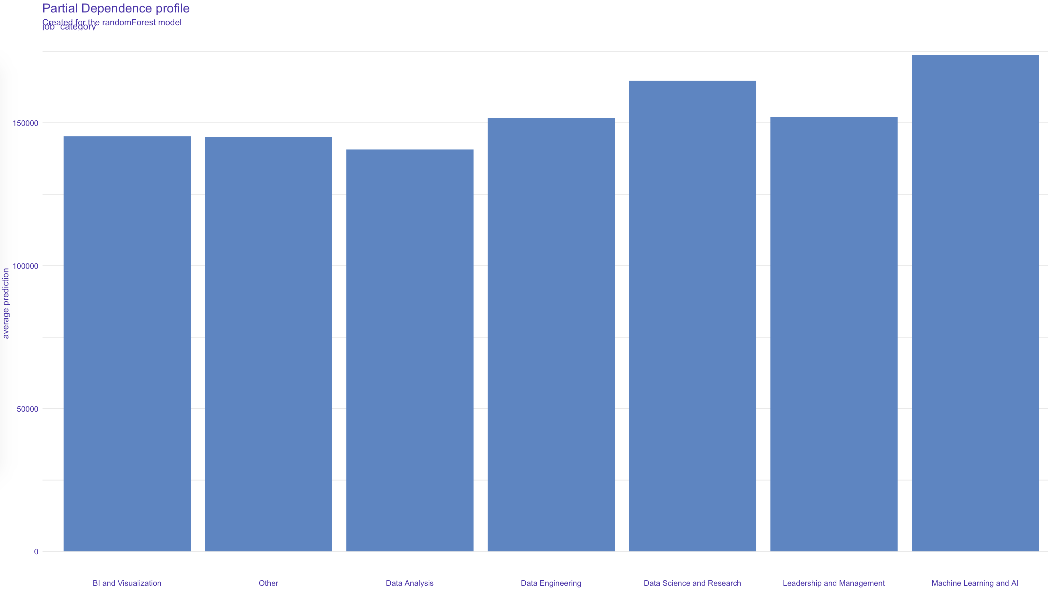
Machine learning and Ai has the highest salary prediction
175000
125000
75000
25000

Slide 9
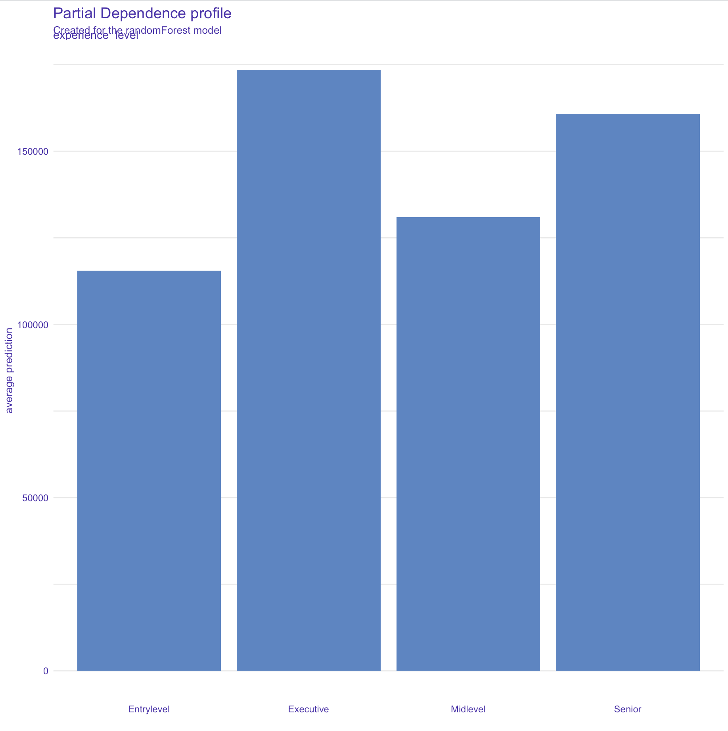
Executive and Senior level jobs have the highest predicted salary
175000
125000
75000
25000
Entry Level
Executive
Mid Level
Senior
Notes:
Average line

Slide 10
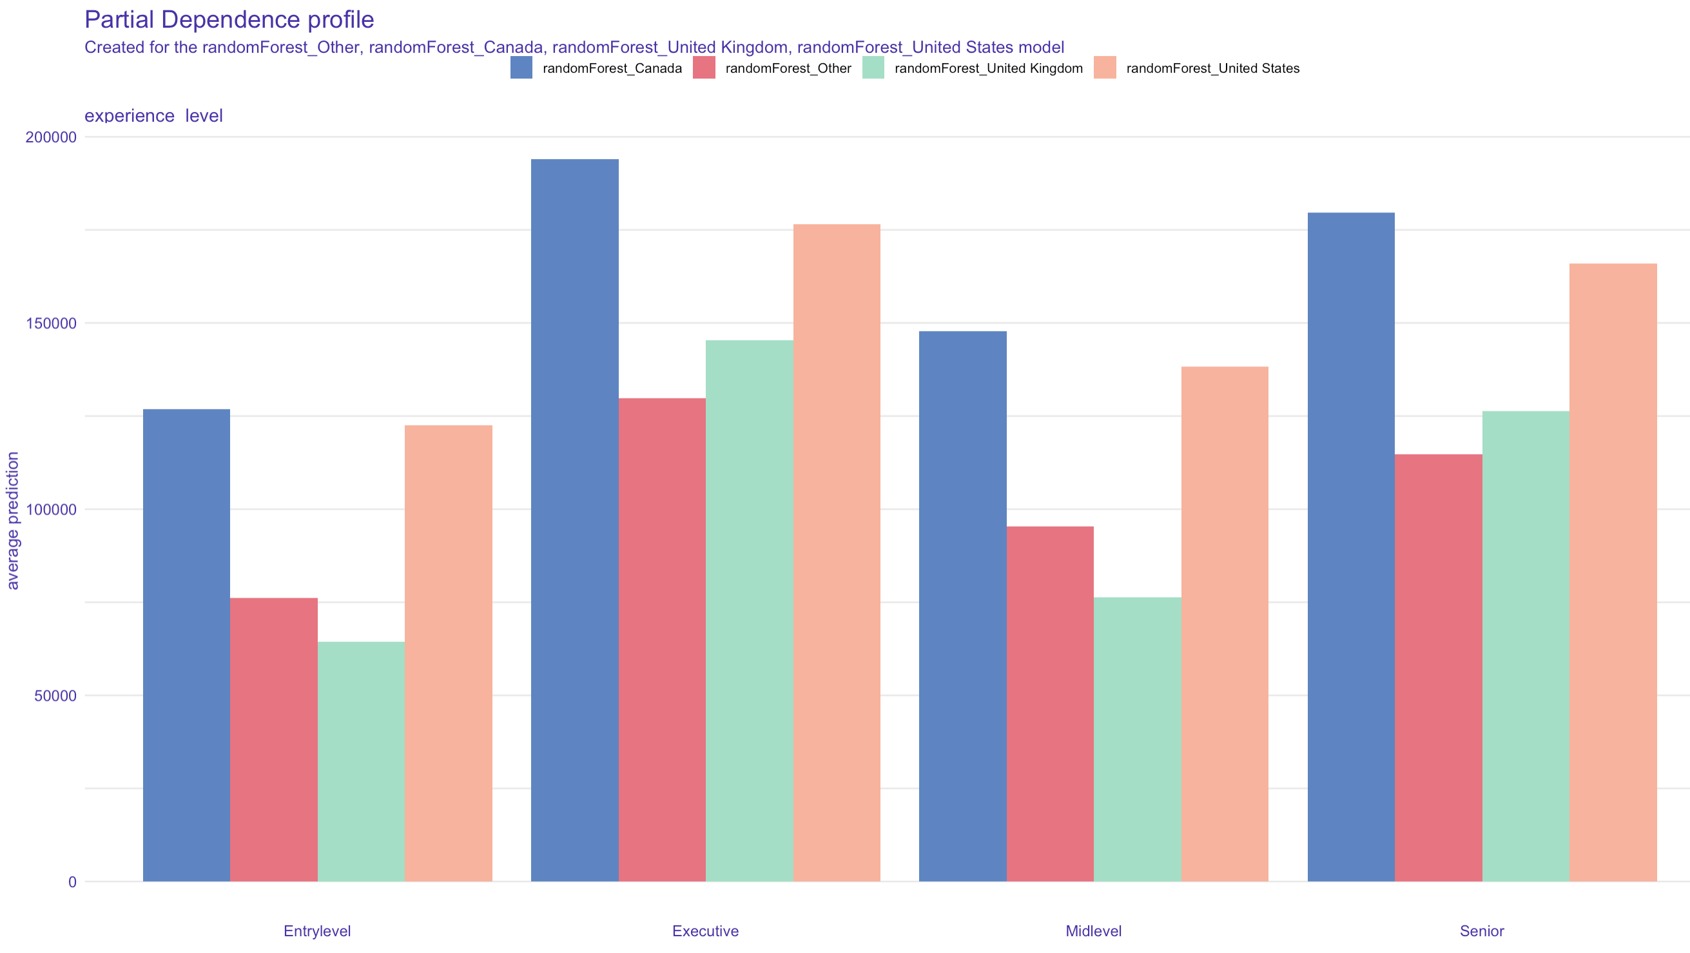
Employee Residence in United Kingdom and Other have significantly lower predicted salaries than Canada and U.S.
Canada
Other
United Kingdom
United States
175000
125000
75000
25000
Entry Level
Executive
Mid-Level
Senior
Notes:
Focus on differences – point out interesting things rather than focusing on all of it.

Slide 11
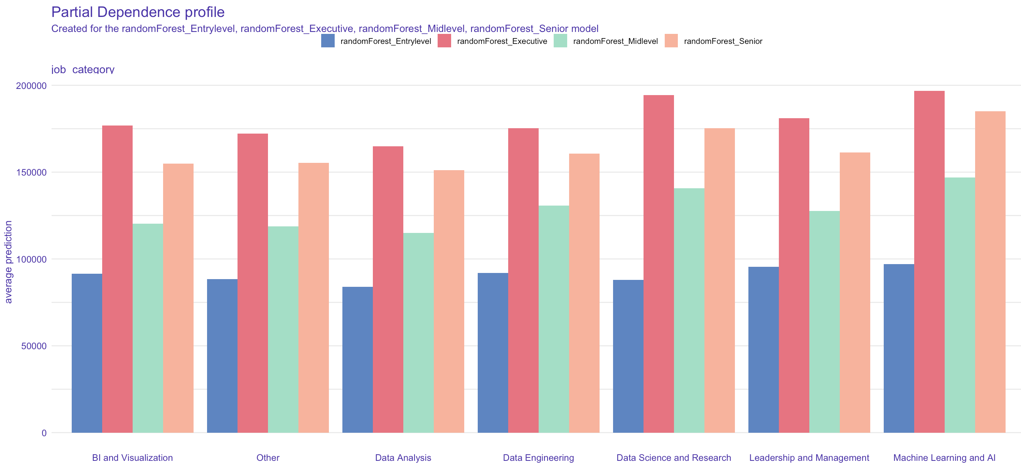
Executive Positions in Data Research Science and Machin Learning have the highest Predicted salaries
Entry Level
Executive
Mid Level
Senior
175000
125000
75000
25000
Notes:
Focus on differences – point out interesting things rather than focusing on all of it.

Slide 12
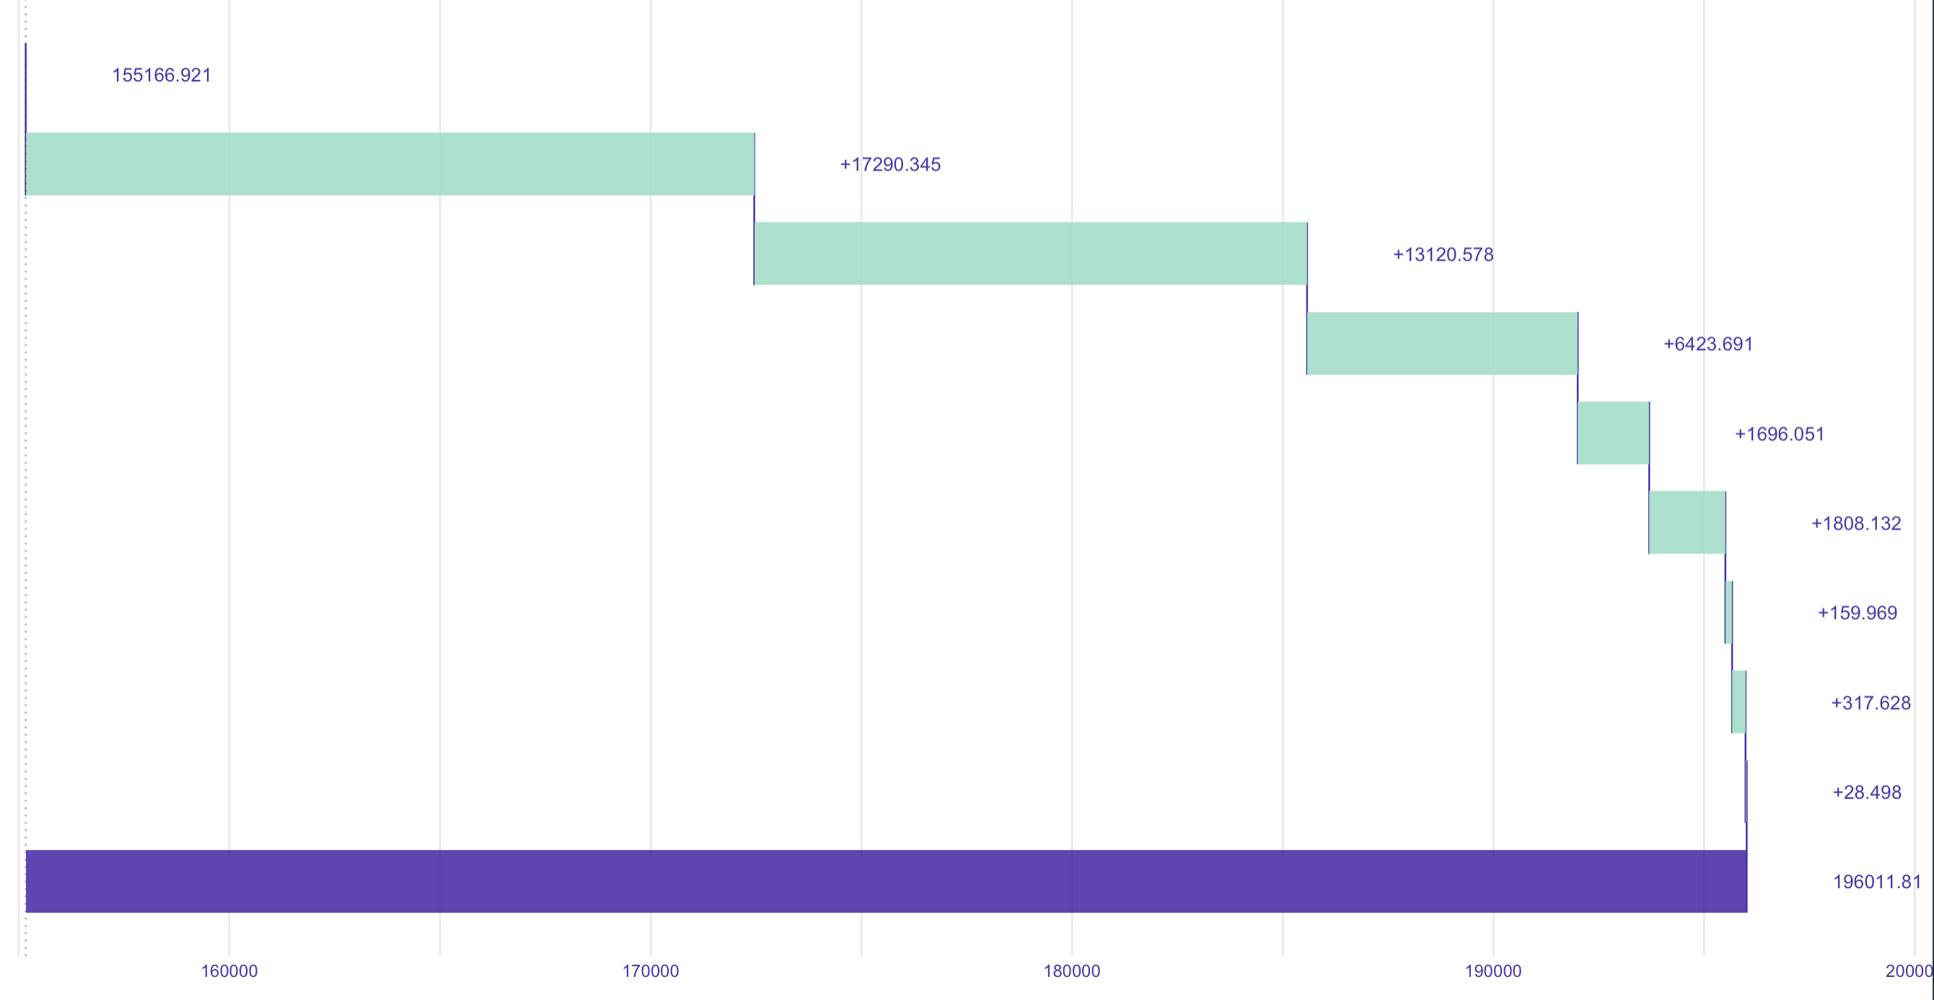
ALL these variables are associated with higher predicted salaries
Average
$155,000
Job Category is Machine Learning and AI
+$17,000
Job Title is Machine Learning Engineer
+$13,000
Experience Level
is Senior
+$6,500
Residence in United States
+$1,700
Company located in United States
+$1,800
Work Setting is In-Person
+$160
Company Size is Medium
+$300
Employment is Full-Time
+$30
All Factors Result is a Prediction of :
$196,000

Slide 13
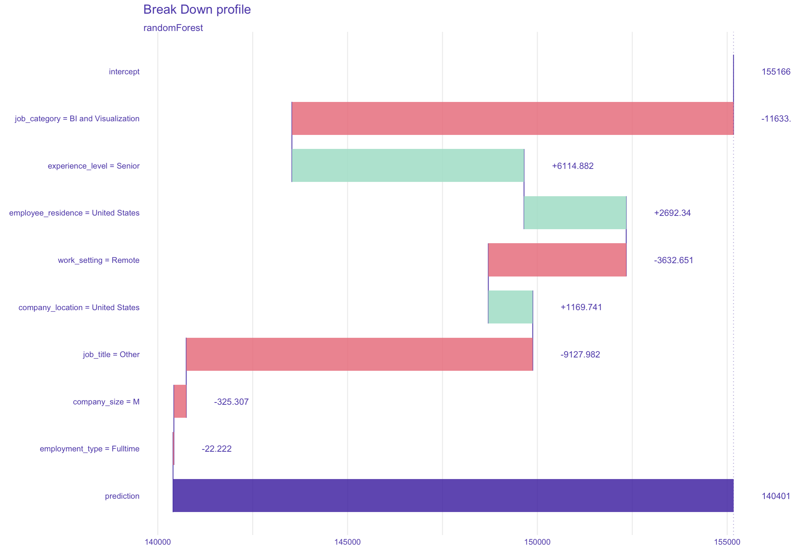
Bi and visualization and job title other than listed are the most detrimental to salary predictions
Average
$155,000
Job Category is BI and Visualization
-$11,500
Other is not:
Data Scientist
Data Engineer
Data Architect
Machine Learning Engineer
Data Analyst
Analytics Engineer
Applied Scientist
Business Intelligence Engineer
Research Scientist
Research Engineer
Data Manager
Experience Level is Senior
+$6,000
Residence in United States
+$2,700
Work Setting is Remote
-$3,600
Job Location is United States
+$1,200
Job Title is Other
-$9,000
Company Size is Medium
-$325
Employment is Full-Time
-$22
All Factors Result is a Prediction of :
$140,000

Slide 14
Predicting salaries is possible!
Looking at Job Titles, Experience Level, and Location will all help predict a jobs salary
Use this model for applying to new analytics jobs to ensure accurate job salary predictions!

