Slide 1
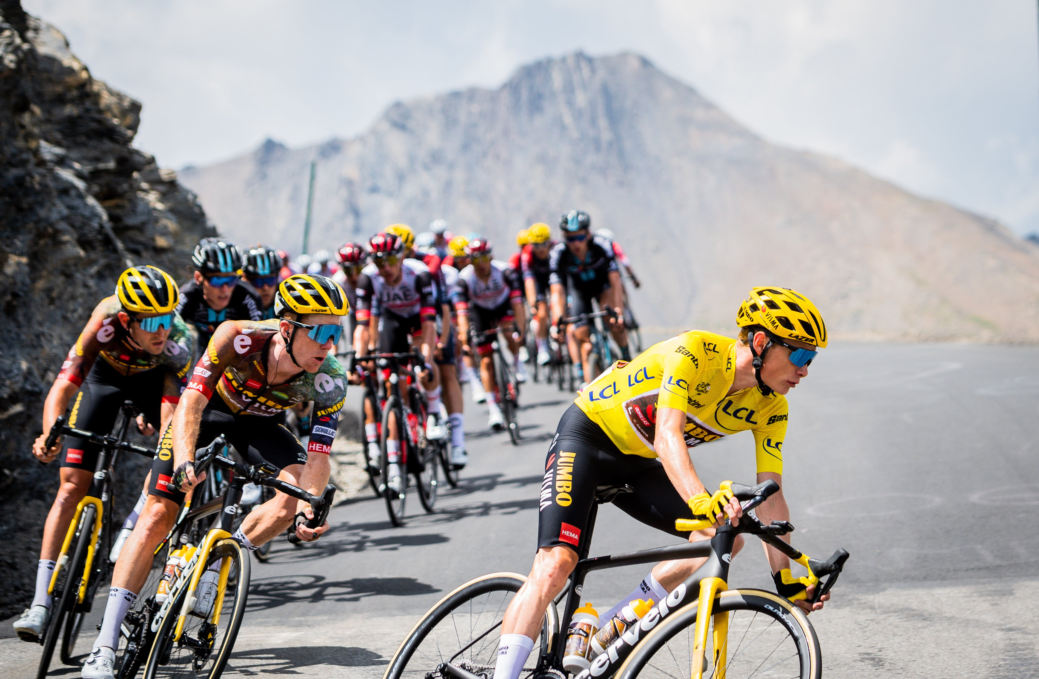
Unlocking the secrets of Tour De France Winners
Dataset from my Mini 2 (Finding Real World Data) Assignment
Maxwell Dean

Slide 2
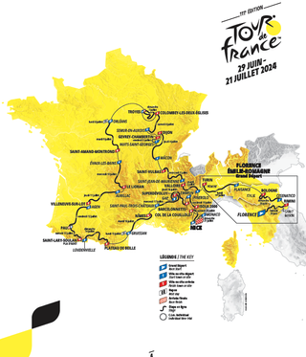
What is the Tour de France?
21 Stages | ~ 2,200 Miles
22 Teams | ~175 Riders

Slide 3
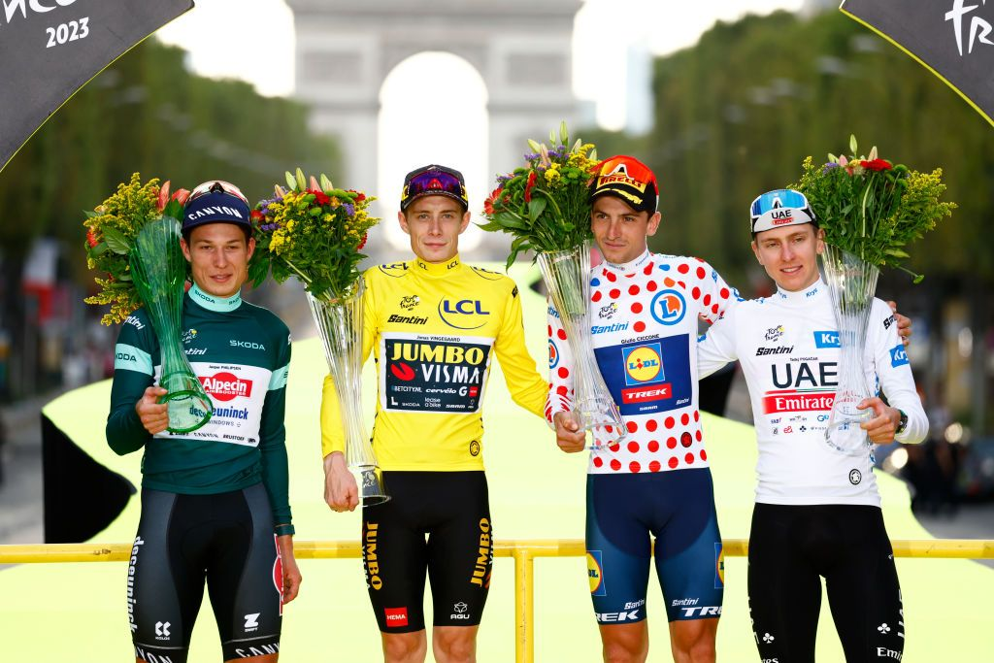
What physical and demographic attributes are most optimal for a rider winning the Tour de France?
Analyzing Tour de France winner data reveals critical factors for success.

Slide 4
Recommendations
Optimal Rider Profile
Height 5’7” – 5’8”
Weight ~145 lbs
Rider Type:
Optimal Demographic
Age 28 – 30
Top 3 Nationalities:
  1) France
  2) Belgium
  3) Spain
Tour Length | 1st Pick | 2nd Pick
SHORT | Climber | Time Trial
MEDIUM | Sprinter | Time Trial
LONG | Sprinter | Climber

Slide 5
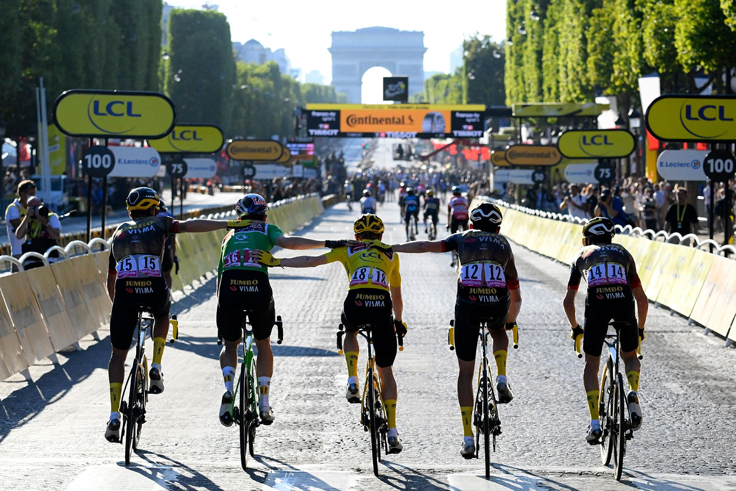
Rider Profile Analysis

Slide 6
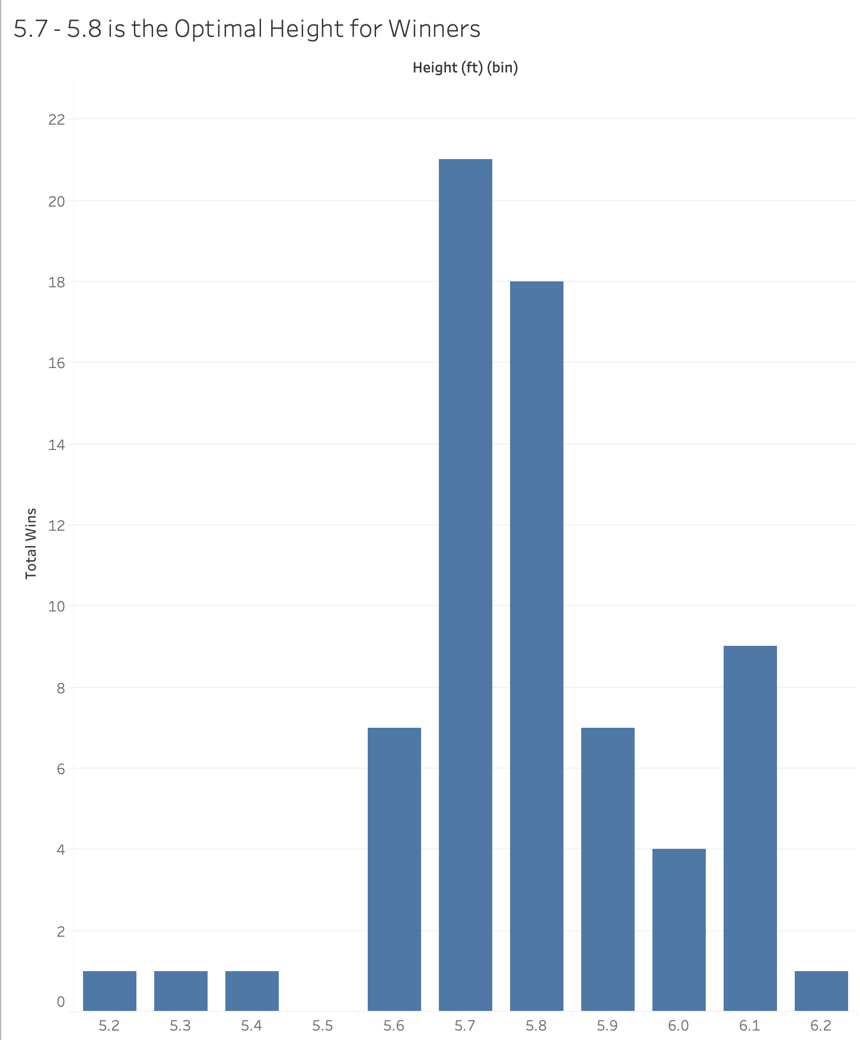
The Optimal Height
for Winners is
5.7 – 5.8
Notes:
- Taller riders might be prone to worse aerodynamics due to size, requiring more energy exertion

Slide 7
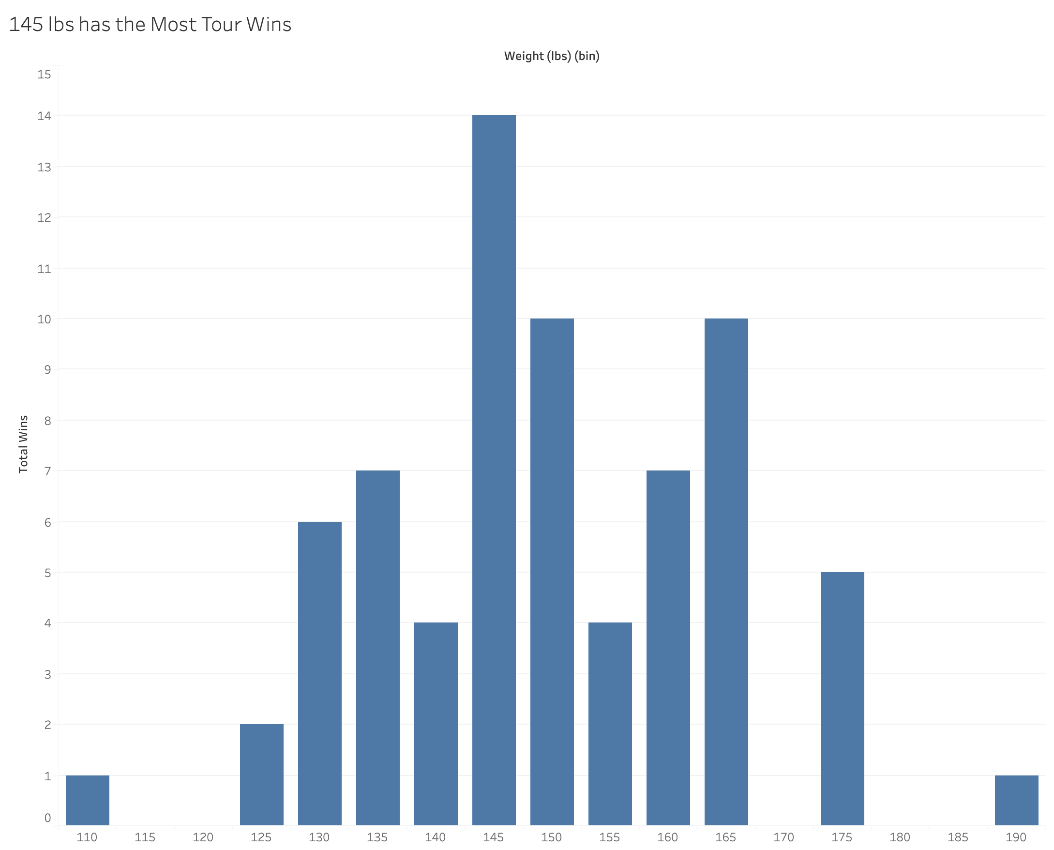
The Optimal
Weight
for Winners is
~145 lbs
Notes:
heavier cyclists have a disadvantage in terms of speed, agility, or climbing ability

Slide 8
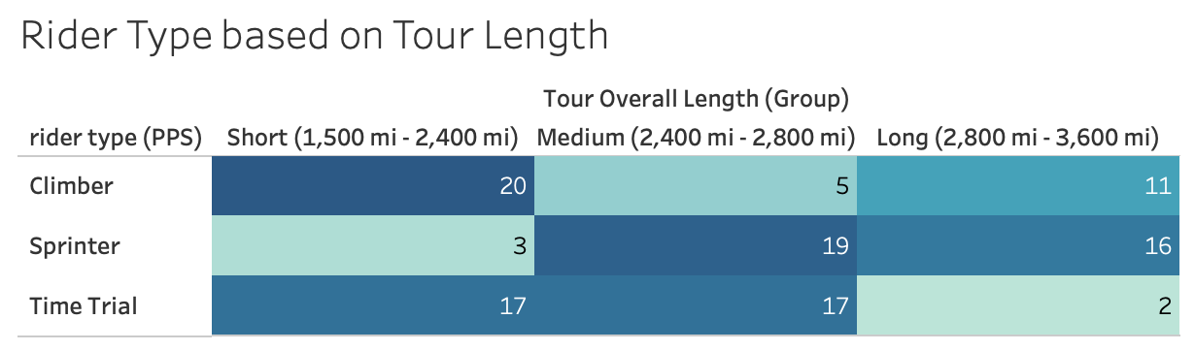

Slide 9
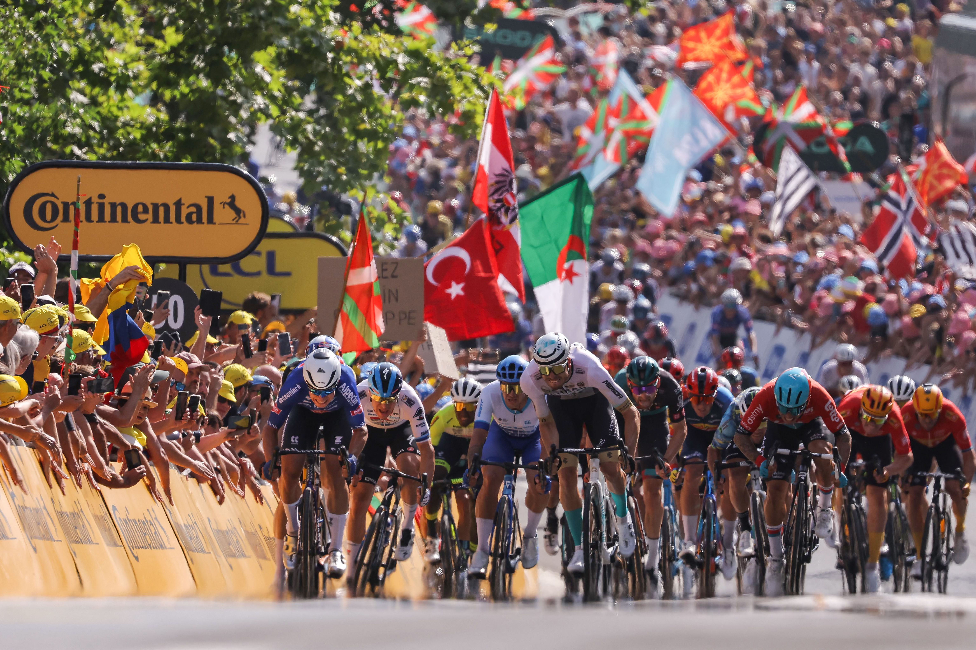
Demographic Analysis

Slide 10
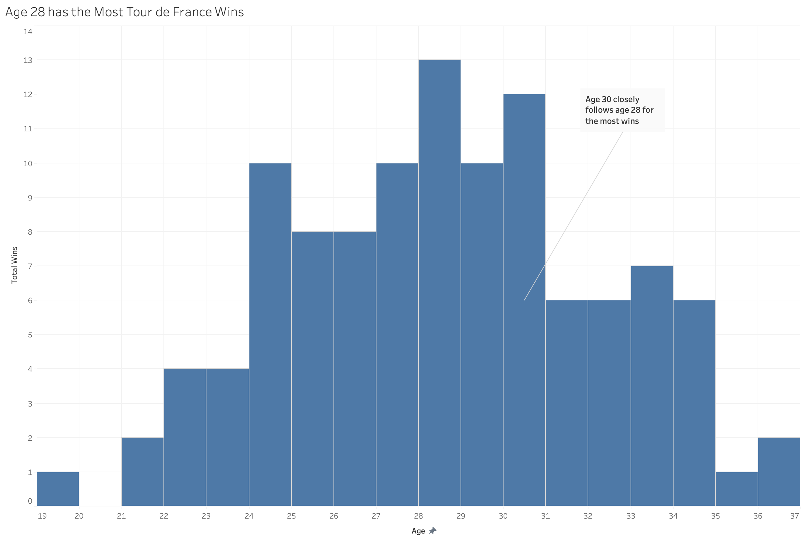
The Age
with the
Most Tour
Wins is
28

Slide 11


Slide 12
Any Questions?

