Slide 1

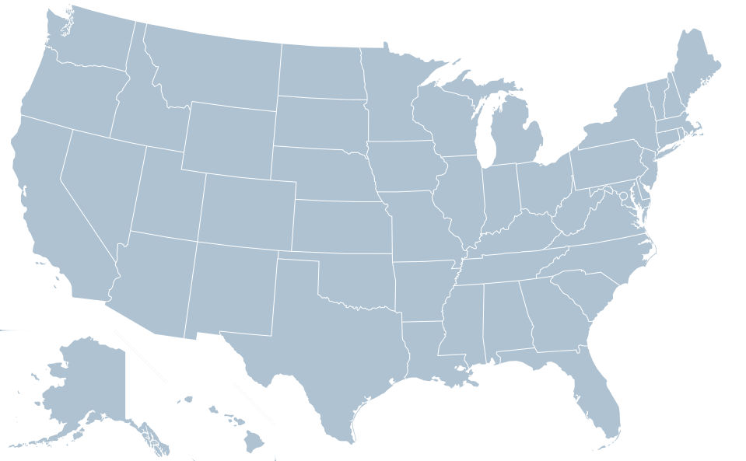
2
1
3
BAS 475: Time Series Analysis Project
Max Dean, Evan Boneta, Paxton Pilgrim, Sanaz Hossain

Slide 2
What is Vatiaion?
A VACATION RENTAL COMPANY WITH MAIN HUBS IN:
ASHEVILLE, NORTH CAROLINA
DENVER, COLORADO
HAWAII
DATA:
Gathered around 1,300,000 total reviews from customer rental experience
  ~800,000 in Hawaii
  ~500,000 in Asheville & Denver
Ranging from January 2009 - November 2022

Slide 3
TASK
Forecast the number of monthly reviews for the next year.
December 2022 - November 2023
Predicting the number of reviews will allow us to track and anticipate future customers' experiences, providing insights into the outlook for Vatiaion.

Slide 4
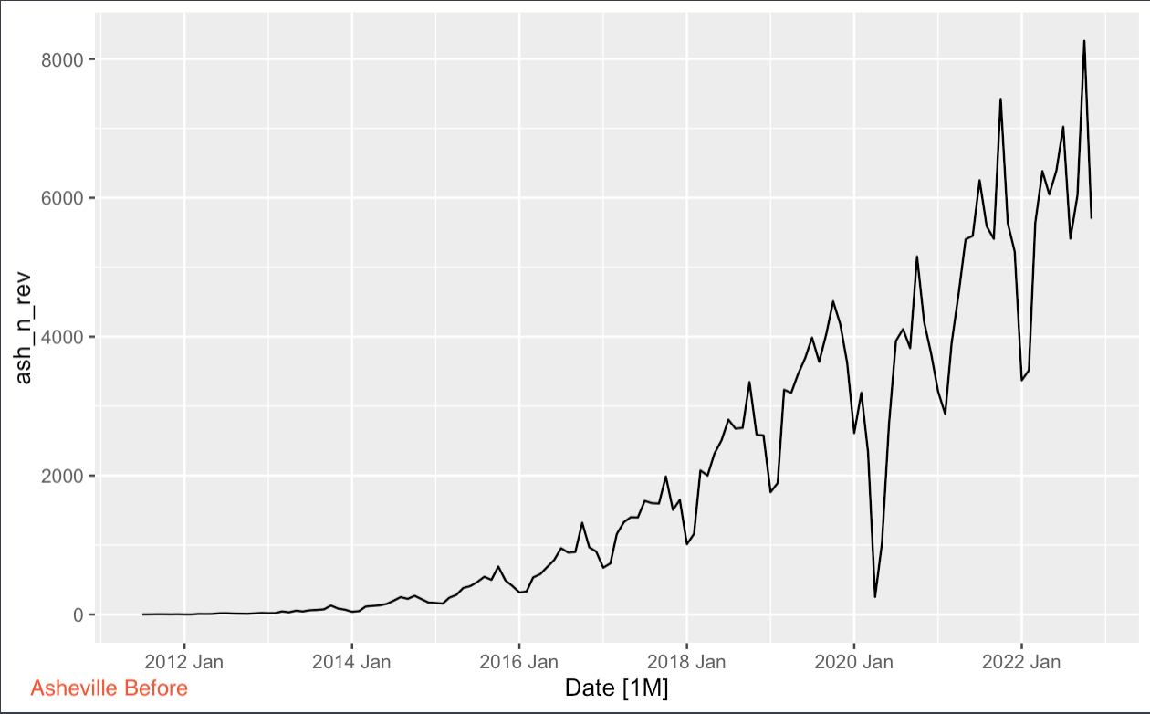
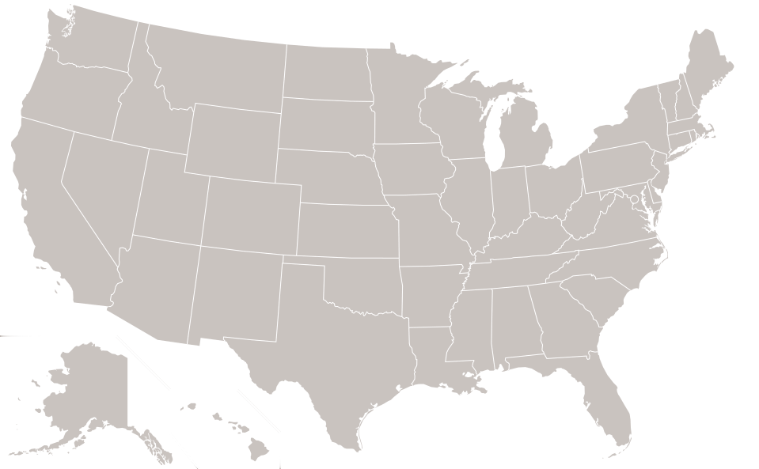
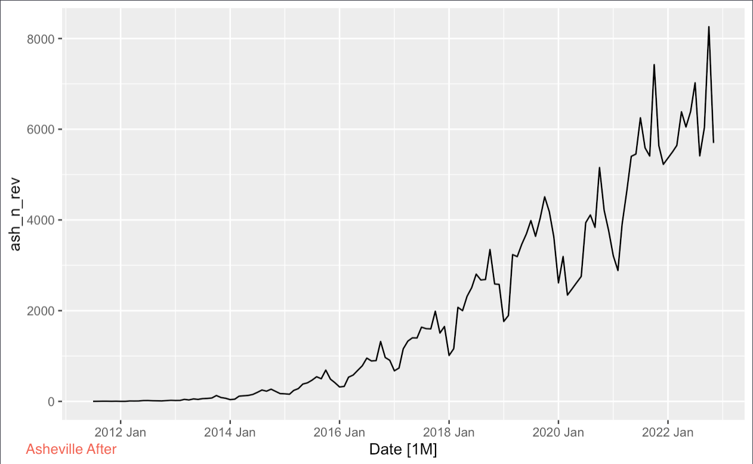
ASHEVILLE
Before
After

Slide 5
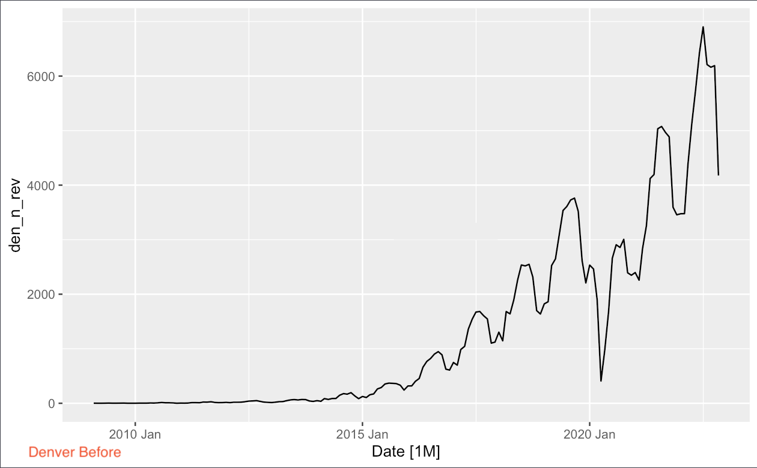
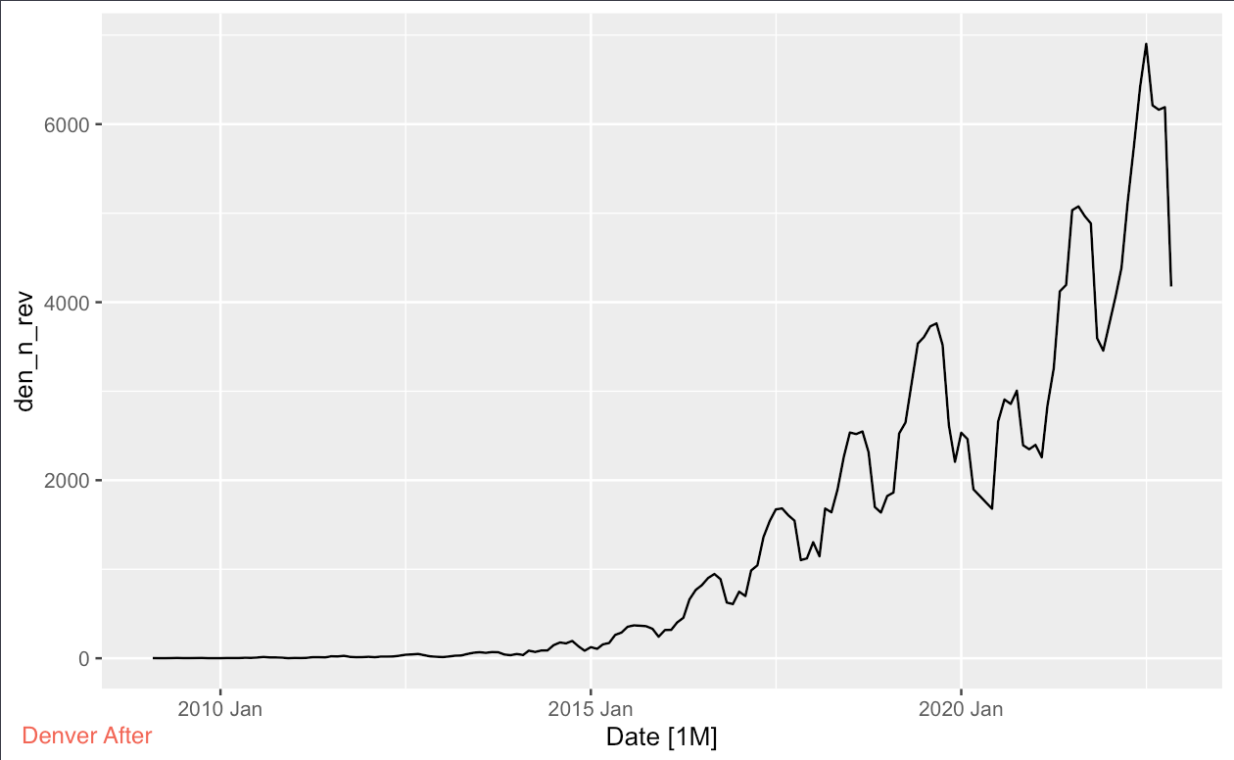
DENVER
Before
After

Slide 6
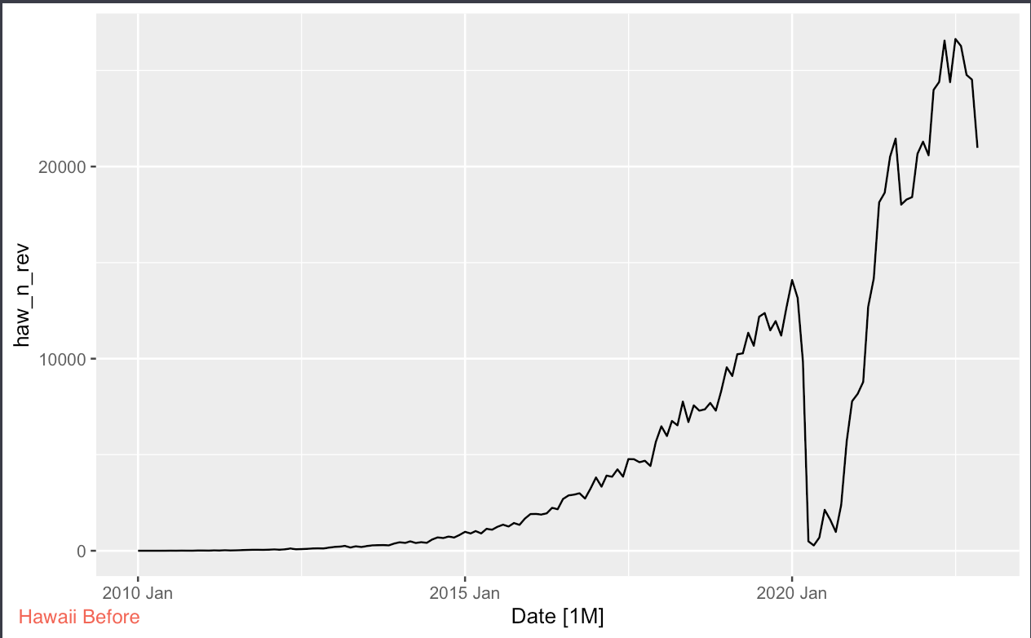
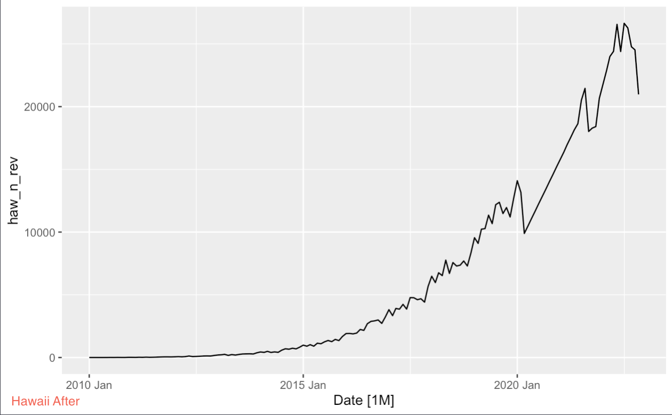
HAWAII
Before
After
Linear Interpolation

Slide 7
To find the overall total reviews we combined all the reviews from each state
HAWAII + DENVER + ASHVILLE

Slide 8
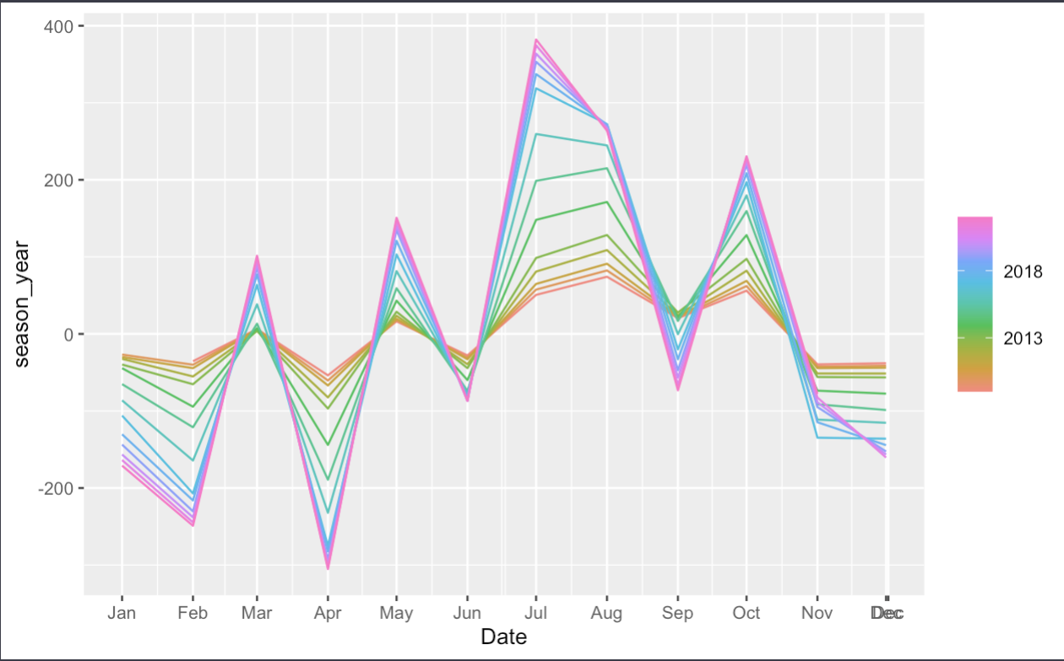
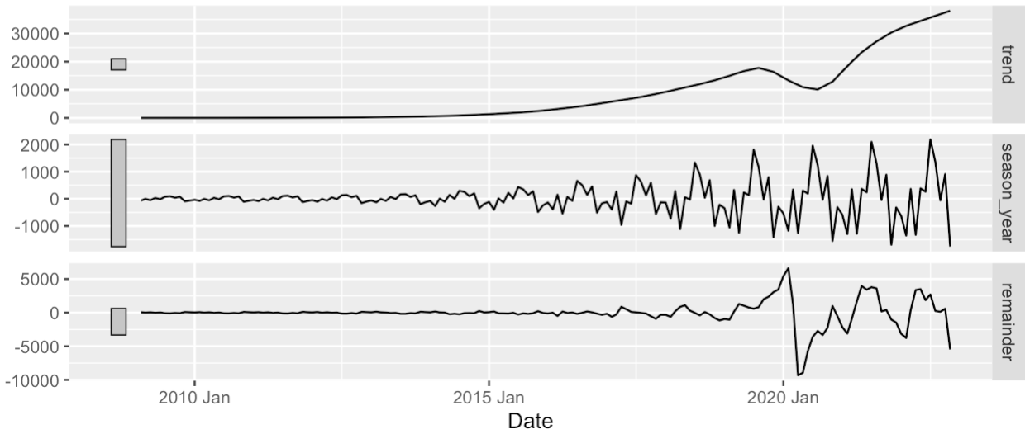
TREND AND SEASONALITY
ALL TOTAL REVIEWS
Summer has the highest reviews consistently
Trend is increasing
Seasonality Strength Multiplies
Covid Irregularities

Slide 9
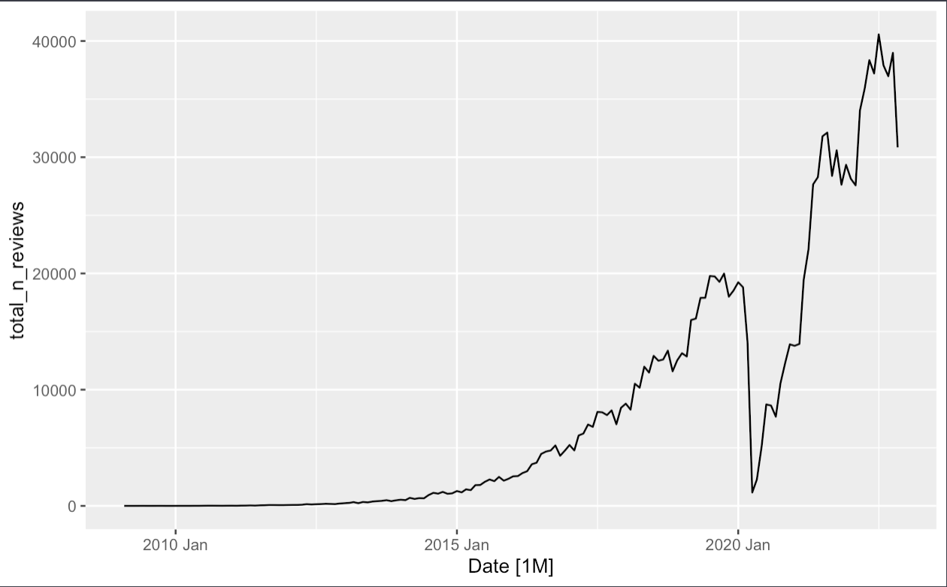
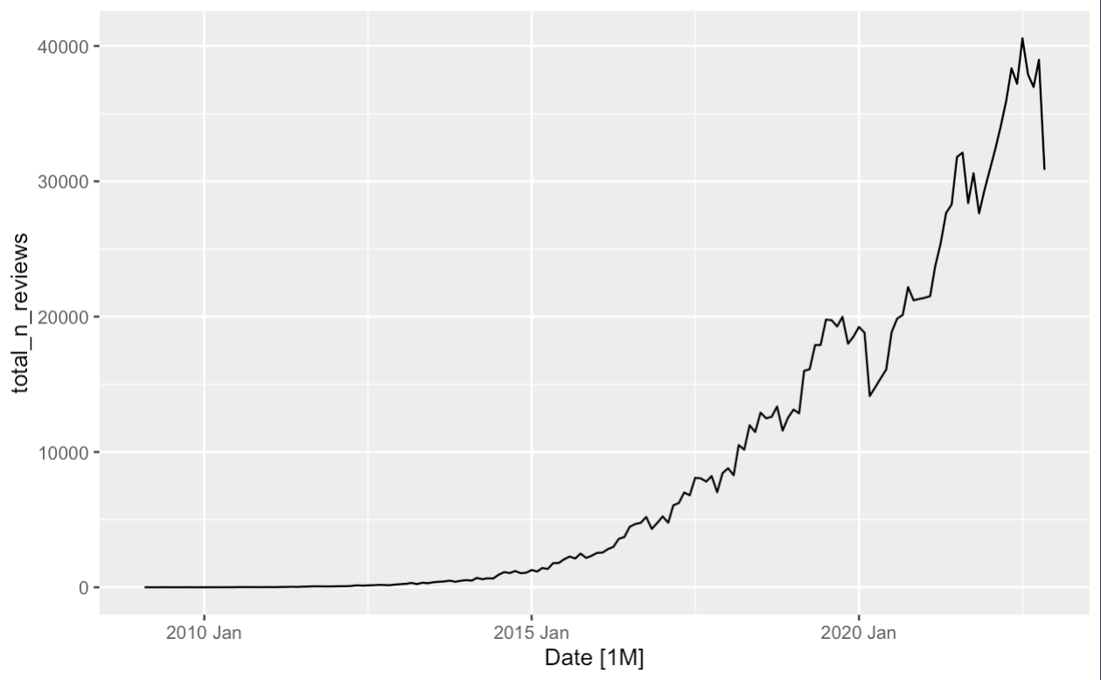
Before
ALL TOTAL REVIEWS
After

Slide 10
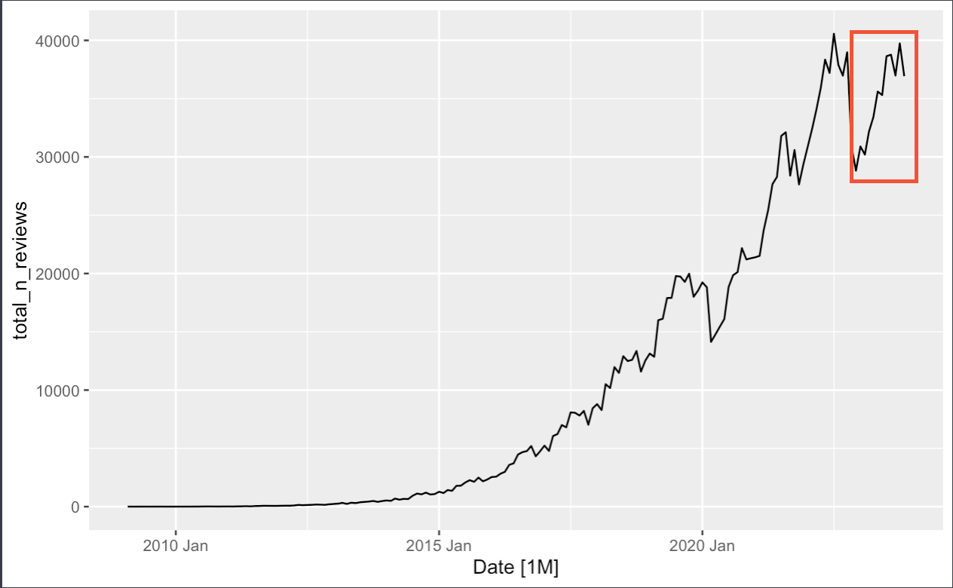
WHAT MODEL WE USED
ETS (Exponential Time Smoothing)
Our model achieves 95% accuracy in predicting future values, with an average error of 2144
Predictions

Slide 11
Our Predicted Values
Month | Number of Reviews
2022 Dec | 28817
2023 Jan | 30898
2023 Feb | 30203
2023 Mar | 32165
2023 Apr | 33425
2023 May | 35609
2023 Jun | 35307
2023 Jul | 38639
2023 Aug | 38772
2023 Sep | 36985
2023 Oct | 39742
2023 Nov | 36930
Our predictions offer:
Increasing trend in total reviews
Mimics historic seasonal patterns

Slide 12
Advanced Time Series Explanations

Slide 13
DATA PREP/CLEANING FOR MODELING
Date Conversion
Converted the ugly “12345” serial date format to interpretable “yyyy-mm”
Data Summarization
Converted each state’s dataset into a tsibble
and summed reviews per month
Handled Missing Values / Outliers
Missing values using forward fill
Outliers due to covid were linearly interpolated
Merged all 3 datasets by Date into 1 combined total reviews for fitting models

Slide 14
Splitting Data for Forecasting:
Prior to forecasting, we split the consolidated data into:
Training Set: Used for training the model.
Used a stretched tsibble with initial window of 24 months and a step of 12 months to determine the best model
Holdout Set: Used for testing the model's predictions.

Slide 15
MODELS WE TESTED
ETS Model (Error, Trend, Seasonal)
Average errors in the 2000-4000 RSME range
ARIMA Model (Auto Regressive Integrated Moving Average)
Average errors in the 3000-5000 RSME range
TSLM (Time Series Linear Model)
Average errors in the 5000-10000 RSME range
*Box-Cox Transformations using Guerrero Method was applied to our models when training them
Notes:
City-Specific Application:
Asheville: ETS for its strong seasonal trends.
Denver: ARIMA for adjusting to its more nuanced patterns.
Hawaii: Combination of ETS and ARIMA, optimizing for its unique seasonal shifts.

Slide 16
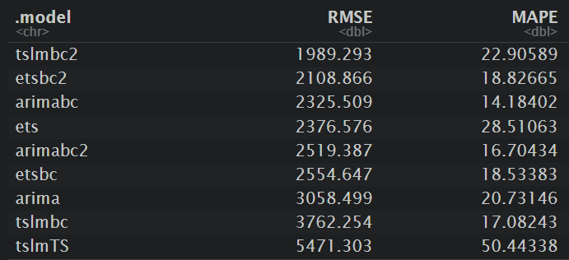
CHOOSING A MODEL
Comparing Models:
  Metrics Used: RMSE and MAPE to measure forecast accuracy.
Model Selection Criteria:
  Preferred models with strong forecasting power,
    Meaning Low RMSE & Low MAPE for more Accuracy
Model accuracies against final combined data using cross-validation

Slide 17
ETS Box-Cox was the Best Fit
On average, our forecast is within 4.61% of the actual values, with a typical error of 2143.68
*Lambda1 = 0.275, Guerrero Lambda = 0.19
Why ETS?:
Excelled in capturing seasonality while managing the positive trend effectively.
Strengths of ETS with Box-Cox:
  Adjusts the data to stabilize variance with the multiplicative seasonality

Slide 18
FINAL PREDICTIONS
Month | Number of Reviews
2022 Dec | 28817
2023 Jan | 30898
2023 Feb | 30203
2023 Mar | 32165
2023 Apr | 33425
2023 May | 35609
2023 Jun | 35307
2023 Jul | 38639
2023 Aug | 38772
2023 Sep | 36985
2023 Oct | 39742
2023 Nov | 36930

